Slide 1
Twitter App Usability Study
February, 2023
UX Research Team

Slide 2
Table of Contents
Section 1 Study Details
Section 2 Themes
Section 3 Insights & Recommendations

Slide 3
Study Details

Slide 4
Project Background
We are conducting a research on the updation of the twitter app to address the pain points of the users. The study focuses on finding the issues users are facing and what new features needs to be added in the existing version of the app for the better, effective and hassle-free use experience.

Slide 5
Study Details
Research Questions
Participants
Methodology
What are the problems users are facing while using the app?
Are there any parts of the app where users are getting stuck?
What are the new features needs to be added in the existing app?
6 participants
3 male and 3 female participants between the ages of 21 - 45 who reside in metropolitan and urban areas.
Participants use Twitter on regular basis to tweet as well as to get the updates.
25-30 minutes
India
Moderated usability study

Slide 6
Themes

Slide 7
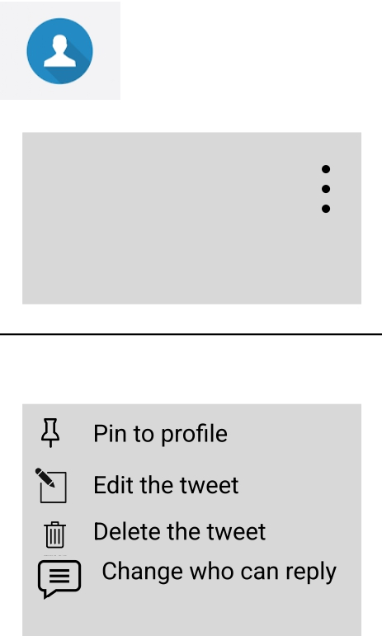
User felt the need of an edit option
Supporting evidence from the usability study:
6 out of 6 total participants wished to have a edit option for the tweets.
4 out of 6 total participants expressed a desire to have it in the3 dots option in front of the tweet.
2 out of 6 total participants expressed a desire to have it along with the re-tweet option.
“Sometimes, I want to edit my tweets, but there is no edit option avaliable so either I delete it and make a new one or I let the tweet as it is. I wish there was an edit option.”
— Dharmendra Choudhary, Twitter user from Bengaluru, India.

Slide 8
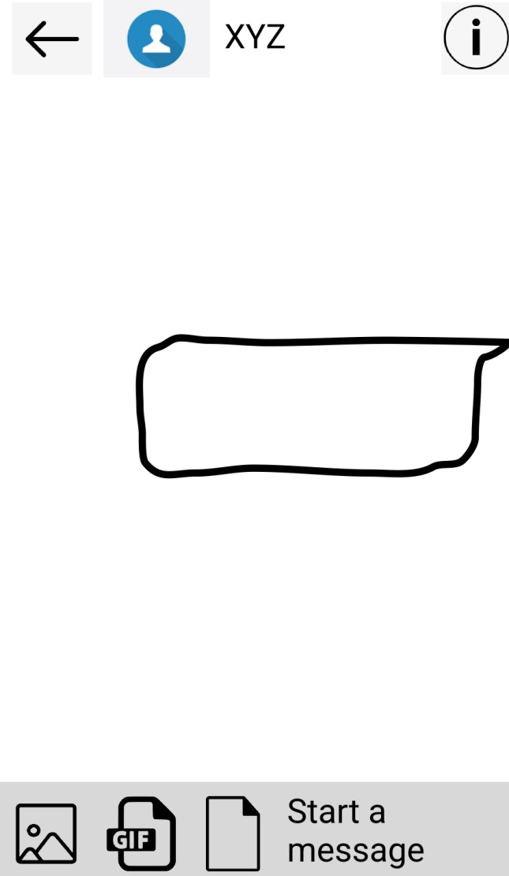
Users felt the need to share the files (pdf, doc) while direct messaging
Supporting evidence from the usability study.
3 out of 6 total participants said they wanted to upload a pdf and doc file in the message tab.
“I use the app regularly and enjoy using it. Sometimes I want to share a file (doc, pdf) through the message but one can only send GIF and images . It would have been nice to have an “attach file” option too.”
— Puneet Agarwal, Twitter User, Ireland

Slide 9
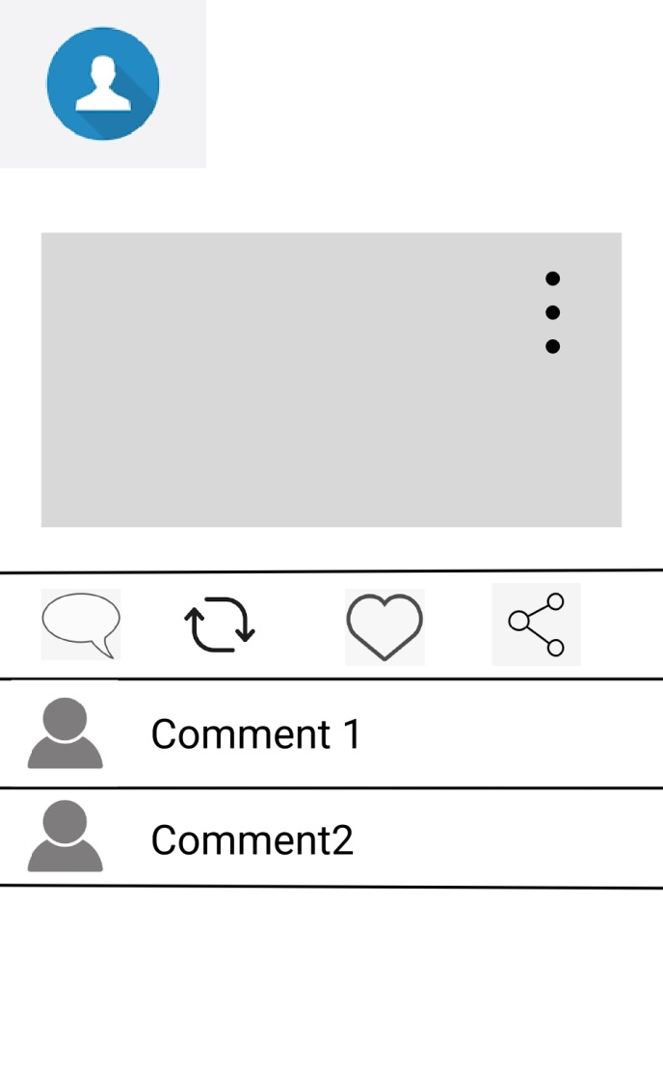
User want to see comments on that particular tweet in comment icon along with the “tweet your reply” option
Supporting evidence from the usability study.
4 out of 6 total participants said they wanted see the comments of others in the same tab where they tweet their reply.
“When I click on the comment icon, I see “ “tweet your reply” instead of comments on that particular tweet as the sign indicate. It would have been easier if I could read comments on that tweets along with the “ tweet your reply” option.
—
Anju Arya, Twitter user from Jaipur, India.

Slide 10
Insights & Recommendations

Slide 11
Research insights
Edit the tweet option
Upload file (pdf, doc) option
All the comments available in comment icon
Users need an option to share file in form of pdf and doc through message.
Users felt the need to have all the comments on that particulatr tweet under the comment icon.
Users need a edit option to make changes in their tweets they have posted.

Slide 12
Recommendations
Add an “edit tweet” option so that users can make changes in their tweets they posted.
Include an option to share files (doc, pdf) in the message section.
Include all the comments on that particular tweet in the comment icon.
NOTE: The theme based prototypes can be seen here;
https://www.figma.com/file/f7XxnuRVhlqpxtgczqSHm8/Twitter-Themes?type=design&node-id=663571%3A448&t=eRbg42H1wcxyR4v0-1

Slide 13
Thank you

